Slide 1
Safexec
A code signing application
John Hardy
4/8/2019

Slide 2
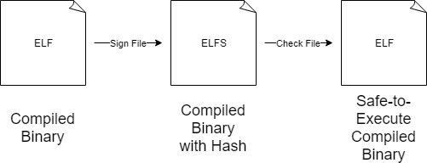
How Safexec Works
My project has two parts:
Create an application that will sign an ELF (Executable and Linkable Format) file.
Result is a new safe-to-execute file format called “ELFS” (Executable and Linkable Format Secure) which is sent to the end user.
At runtime, the ELFS file is checked to ensure that it has not been modified. The file is then turned back into an ELF file.
Target audience:
Anyone who downloads or uses code from a questionable source
i.e. Digital Forensics Investigators, White Hat Hackers, Casual Deep-web Users

Slide 3



What I Have Accomplished
Through this project I have completed the following tasks:
Hashing files of any size using a hashing algorithm
Manipulation of files and navigation of the file system in Python
Implementation of a rigorous unit testing framework to patch bugs
Building a familiarity with Python and common Python libraries
Learning about modern hashing algorithms
Modifying files using hexadecimal file editor software
Understanding the basics of code signing

Slide 4

Why I Made Safexec
Why I am interested:
Cryptography is fun!
I wanted to work on a project that would focus on my future career
I want to make my own application from scratch
How it has challenged me:
Uses many of my software development skills
Challenges me to work on a tight schedule
Forced me to get out of my comfort zone

Slide 5
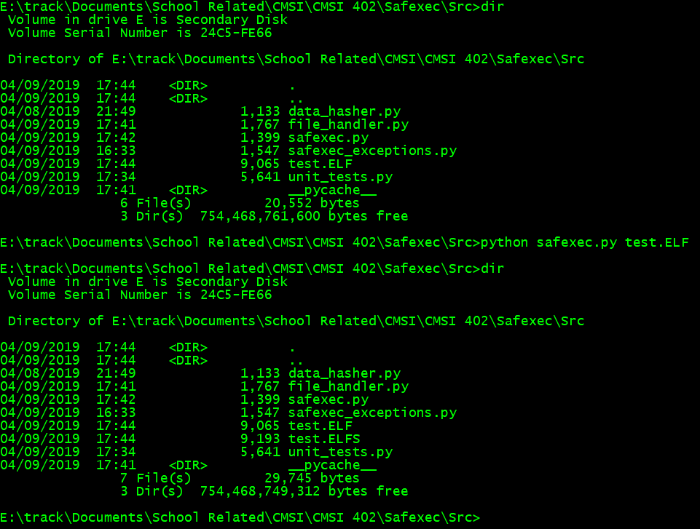
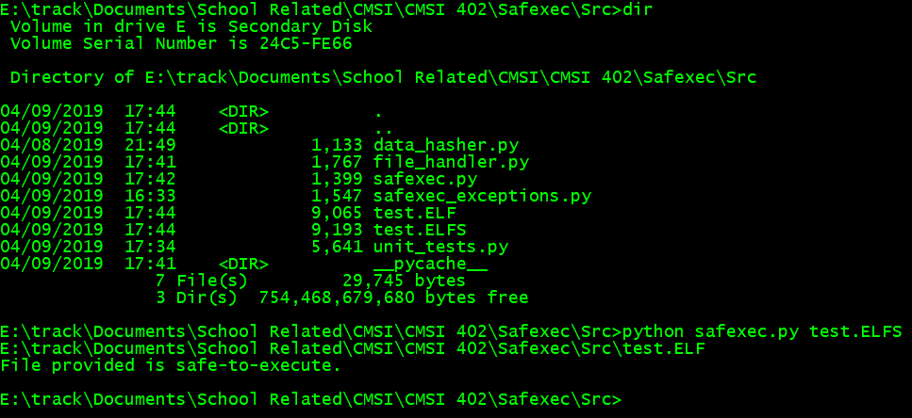
User Interface Examples and Demonstration
At this point, the application is not very user-friendly 😬, but it works.
Signing an ELF File
Checking a Signed ELFS File

Slide 6

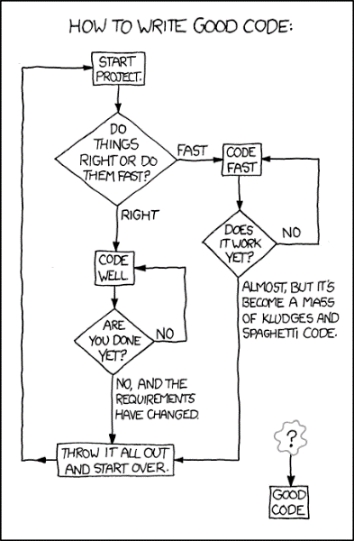
Challenges Encountered
My greatest challenge has been staying on schedule and working continuously.
With only one set due date for my project to be turned in on, I have had difficulty not procrastinating on my work.
My largest problem faced was discovering that ELF file headers where too small to fit a large 64byte hash inside of them.
My solution was to create an entirely new file type called ELFS.
I have also faced challenges creating effective unit tests that cover all of the parts of my code and ensure that everything works as expected.
I have implemented custom Python exceptions to make input testing much easier.

Slide 7
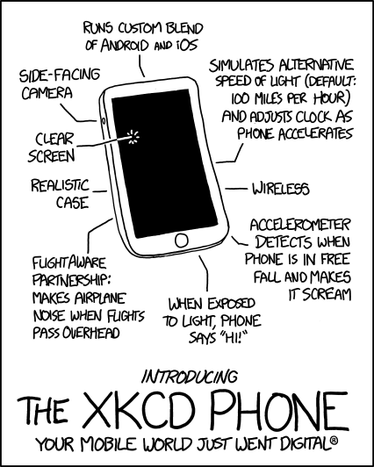
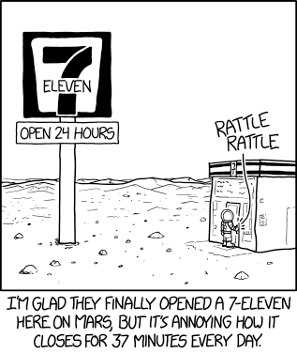
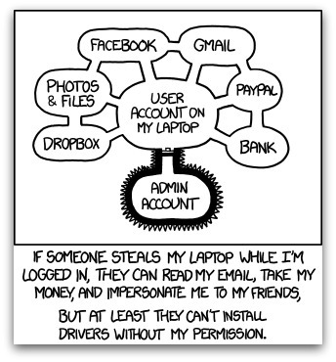
Status Update
To Do:
Modify Ubuntu Operating System to recognize ELFS files
Implement Safexec code on the Ubuntu OS
Create a “nice” user interface
Release project on GitHub
Relax!

Slide 8
Questions?
Safexec
John Hardy

